Slide 1

Exploratory Data Analysis & Cleaning in SQL: Video Game Dataset Skills Used: SQL, Power BI, Data Cleaning and Data Visualization
Introduction
This dataset contains a list of video games dating from 1980 to 2023, providing data such as release dates, user review rating, critic review rating, and more. The original dataset includes errors, duplicates, null values, inconsistencies, invalid data types, and other issues that need to be addressed before it can be used for analysis and drawing key insights.
Business Problem
One of my friends was tasked with the difficult decision of trying to decide which video games to purchase for himself and his friends. I found this data set from Kaggle to help analyze and explore the top 100 video games on "backloggd" from 1980-2023 in order to create a detailed definitive gaming database that I could share with others with a similar problem. The dataset cannot be used for analysis as it is, so I had to clean it up, properly format the columns, and make sure the data is valid, in order for it to be used to complete the request.
Aim
The aim of cleaning this dataset is to ensure that the data is in the correct format, consistent, well-organized, and clean enough to be valuable to my client (my friend) and any other third party seeking to use the data. Our objectives are as follows:
Eliminate errors.
Remove redundant and unnecessary data.
Enhance data reliability.
Ensure accuracy.
Maintain consistency.
Dataset
This dataset is of medium size and originally consisted of 15 columns, including the rowid:
The dataset contains 1,513 rows, including the column header.

Slide 2
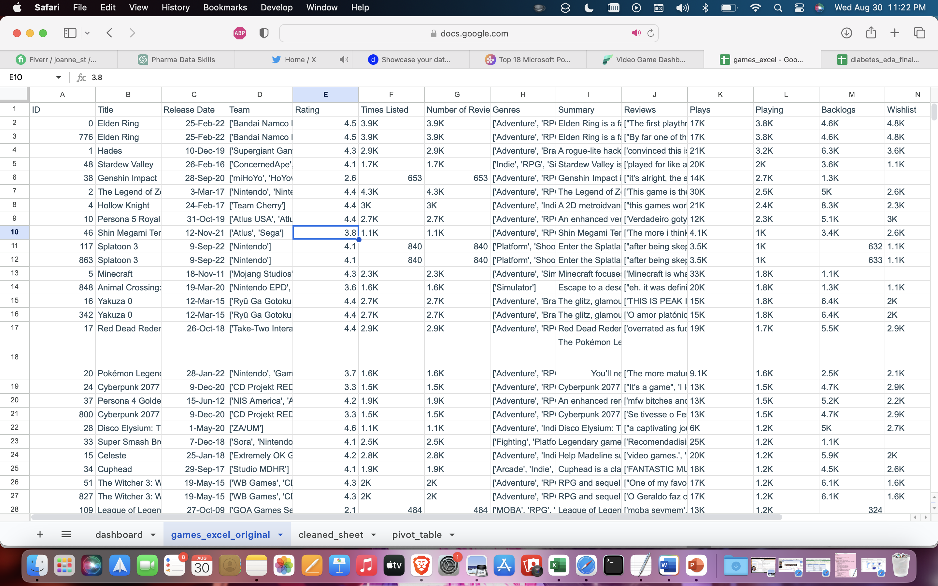
Original Dataset

Slide 3
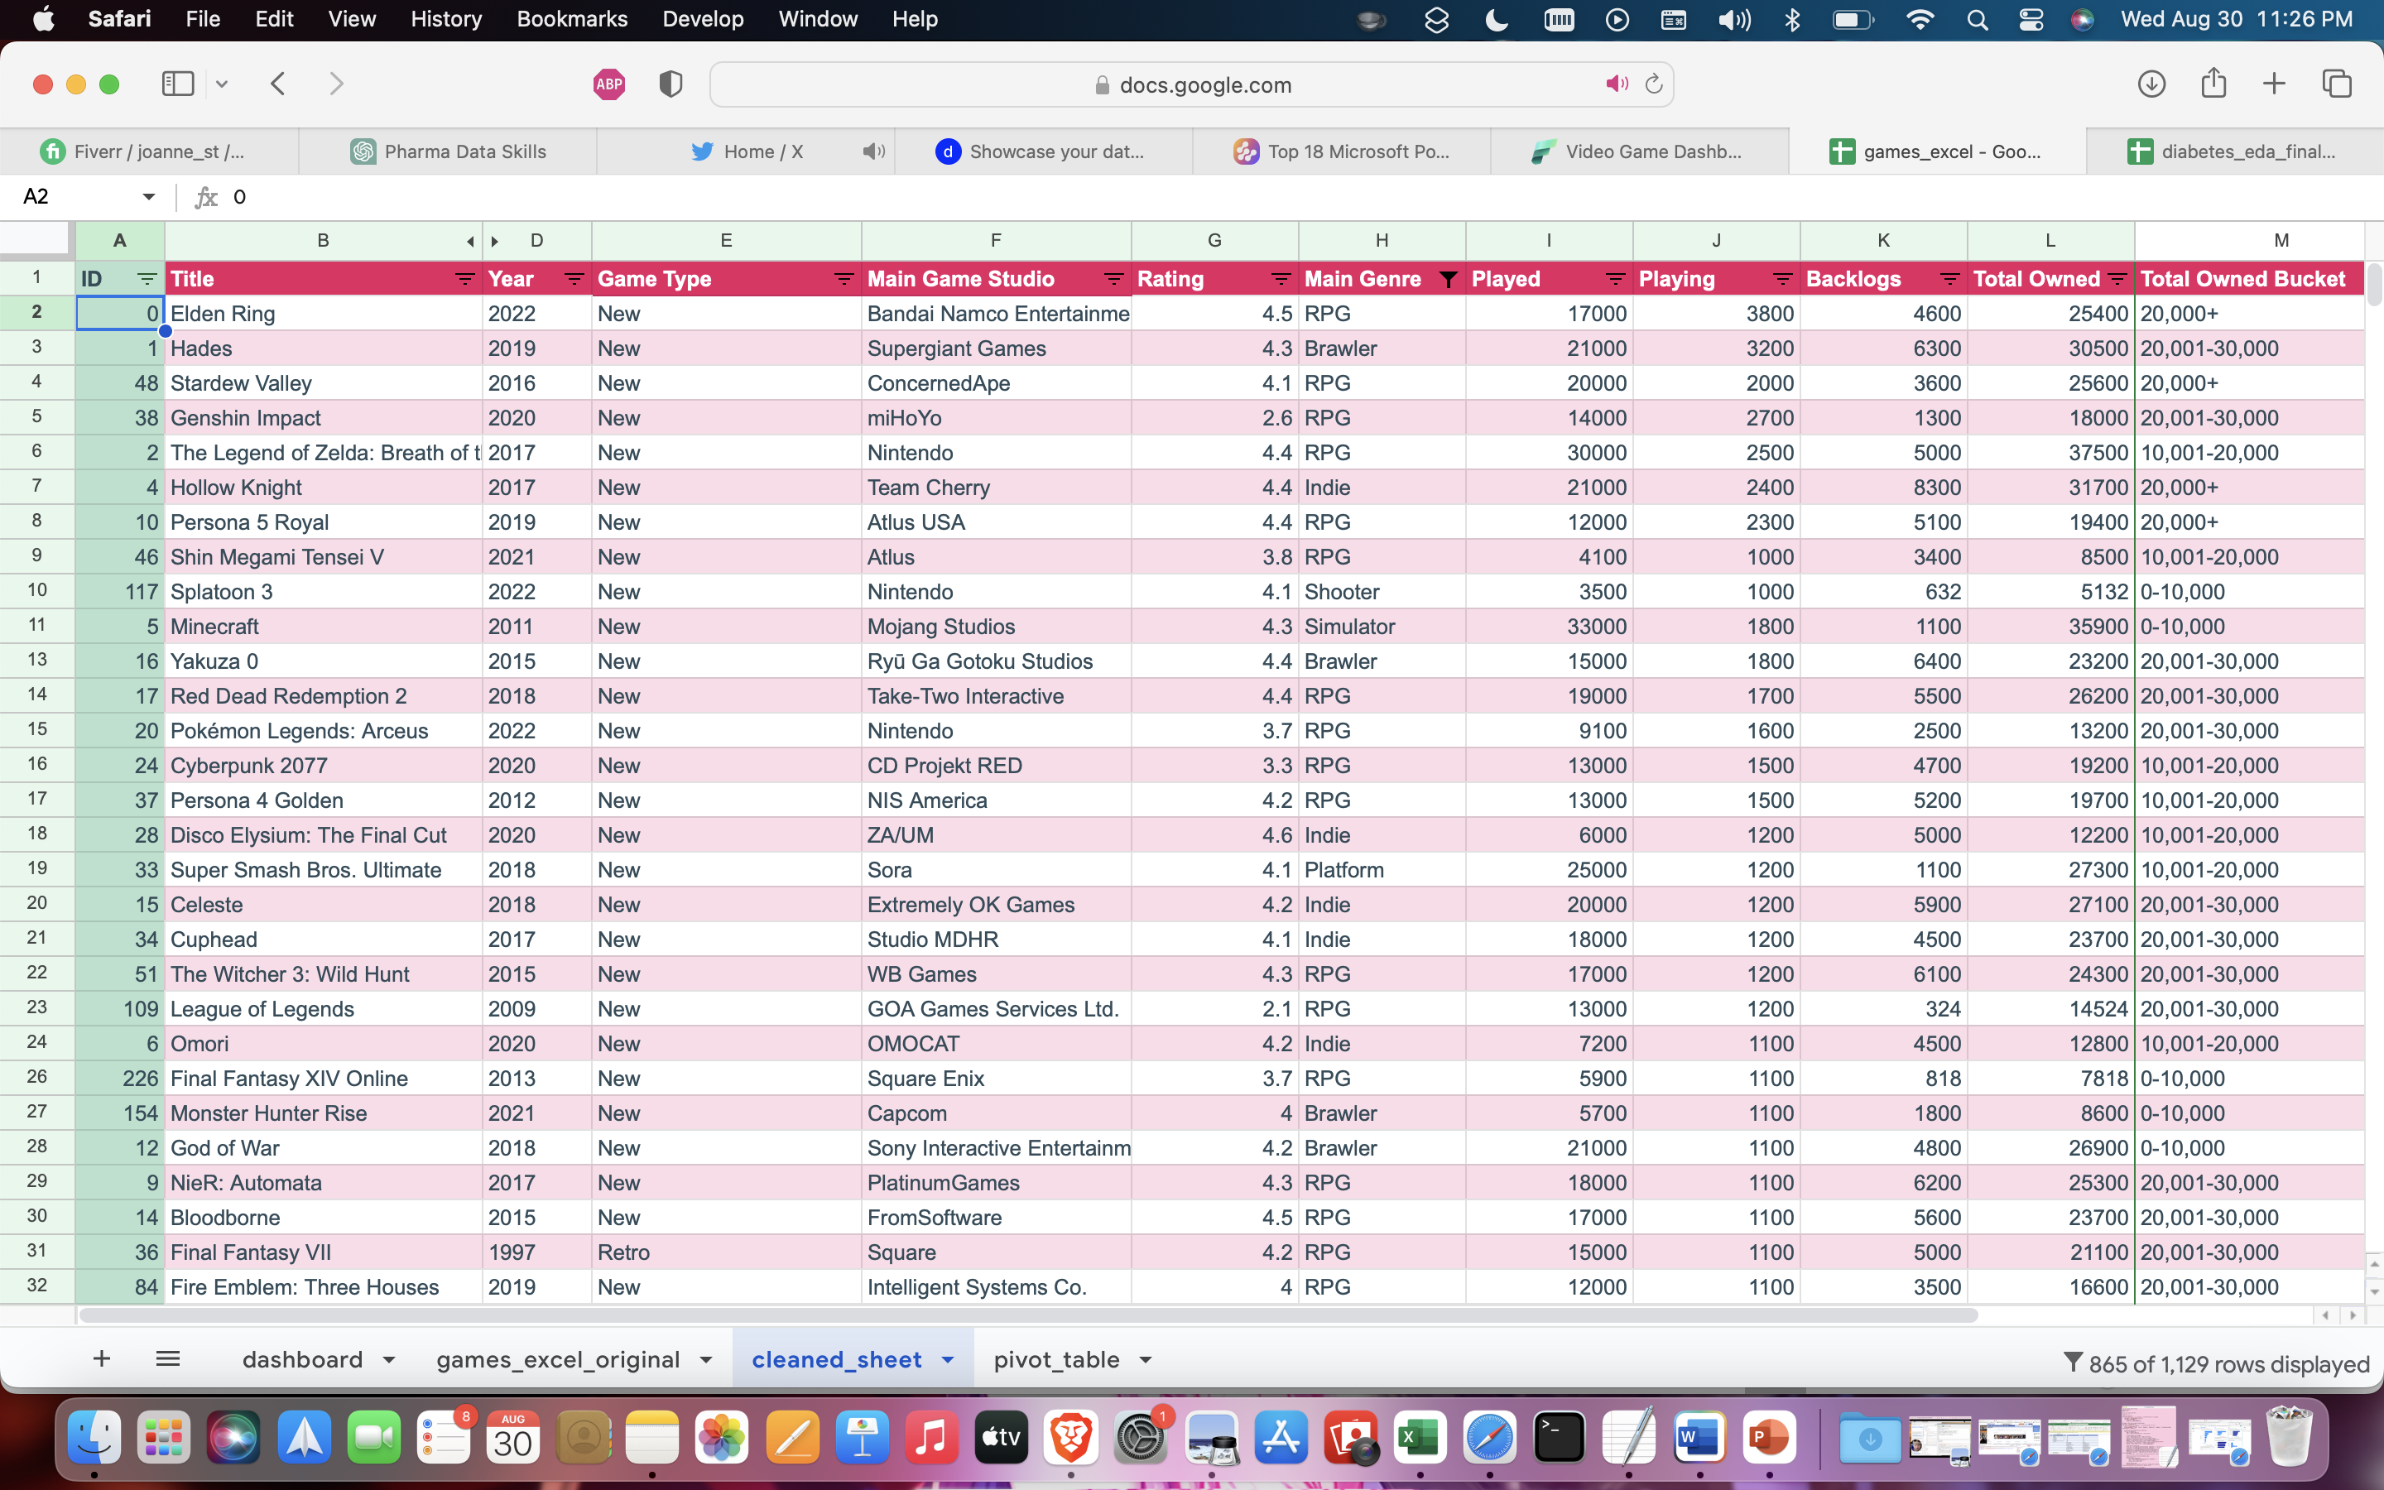
Cleaned Dataset

Slide 4
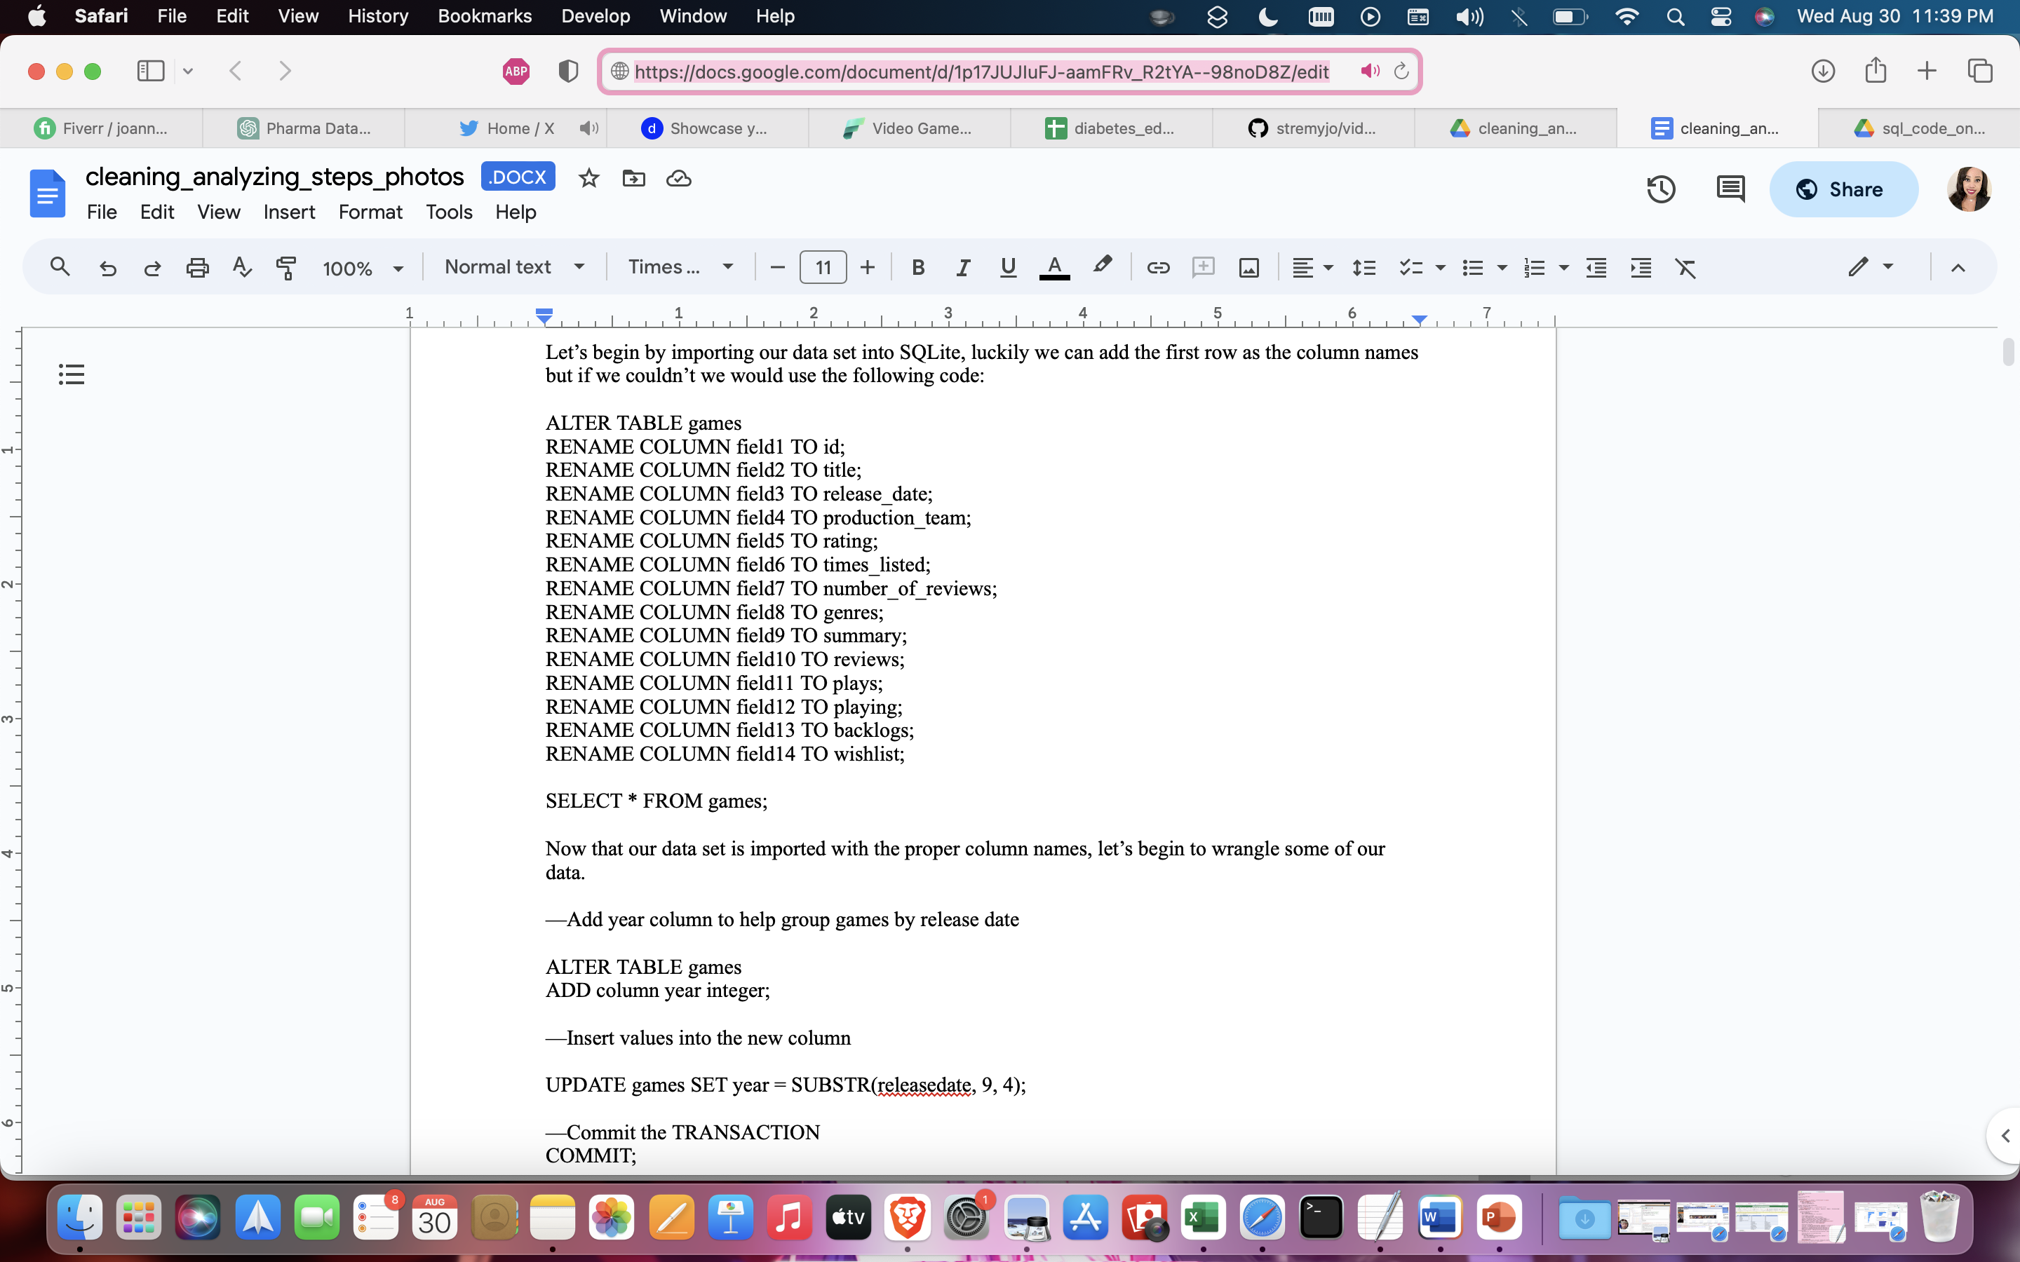
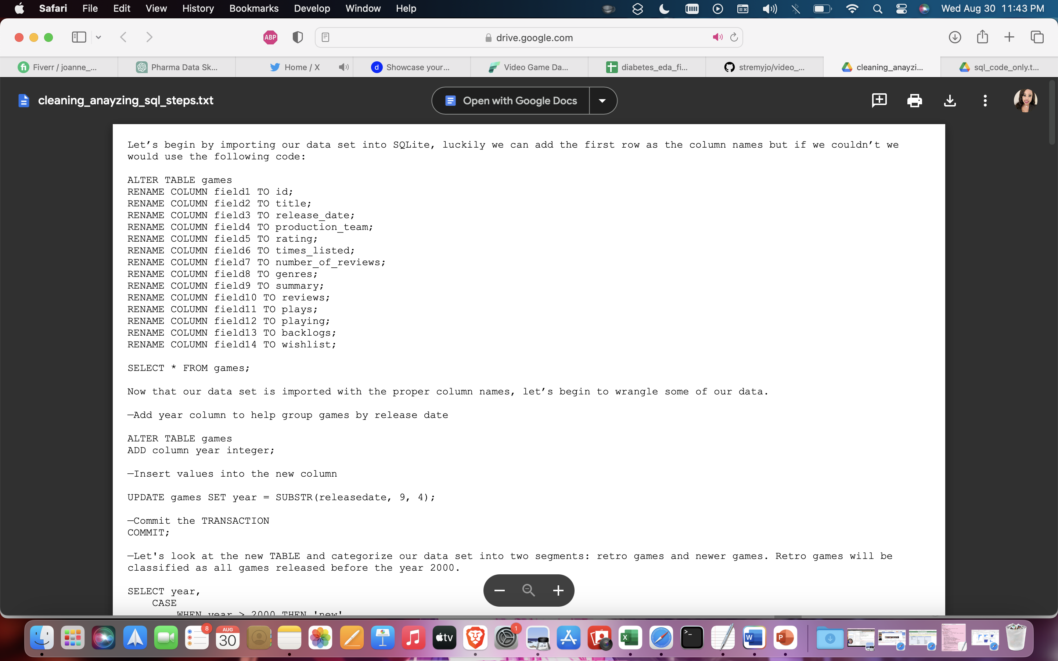
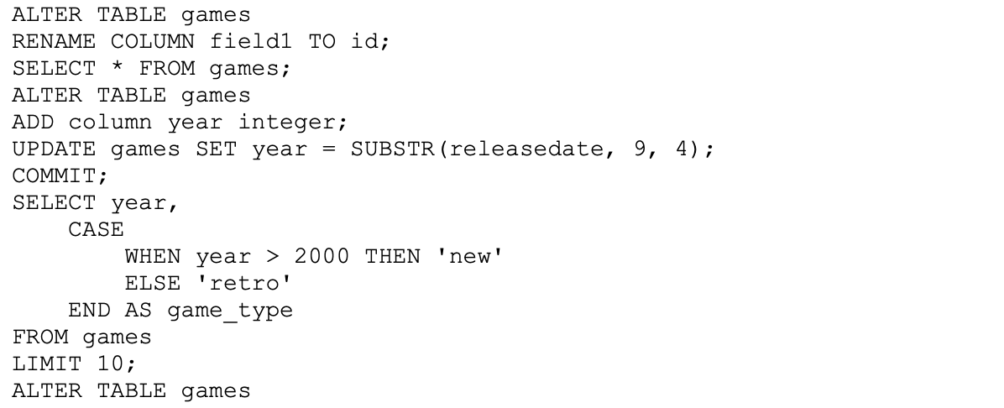
Exploratory Data Analysis & Cleaning in SQL: Video Game Dataset Coding Steps & SQL Code Links
Coding Steps Detailed
Detailed SQL coding steps with tables and screenshots.
Coding Steps Condensed
Condensed SQL coding steps with text and descriptions for each code ONLY.
SQL Code ONLY
SQL coding steps ONLY.

Slide 5

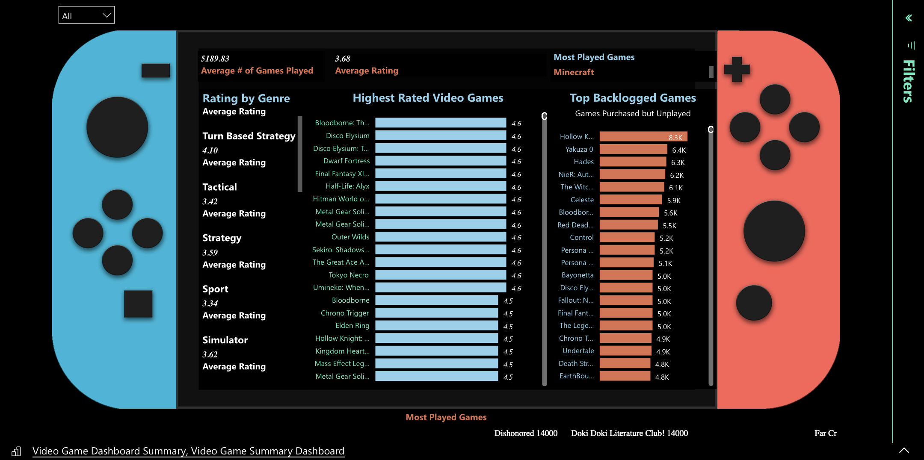
Microsoft Power BI Dashboard

Slide 6
Other Projects Skills Used: R Studio/R Programming, Python, Microsoft Excel
Python for Beginners Guide – Medium
Created a concise and beginner-friendly Python guide, simplifying entry into programming.
Facilitated easy understanding of core Python concepts, supporting newcomers in their coding journey.
Python: Text Classification Model for News Articles Project – Medium | GitHub
Successfully executed a beginner-friendly Python project focused on text data cleaning and processing.
Developed a robust model for categorizing news articles based on their content, demonstrating proficiency in data preprocessing, tokenization, and machine learning.
Implemented Natural Language Toolkit (nltk) techniques to remove stop words, perform stemming, and create a categorization function using relevant keywords.
Achieved exceptional accuracy in categorizing news articles using a Multinomial Naive Bayes classifier, showcasing the ability to apply fundamental data science concepts to real-world challenges.
Exploratory Analysis: Demographic Impact on Diabetes – Dashboard | GitHub | Case Study
Conducted exploratory data analysis on diabetes-related data using R, Excel, and Power BI.
Utilized "MEPS HC-228" dataset for insights into diabetes trends and correlations.
Crafted interactive Power BI dashboard, visualizing key diabetes patterns and insights.
Enhanced data-driven decision-making and potential applications in public health initiatives.
Communicated findings through visualization and analysis, contributing to public health understanding.
Video Game Dataset Cleanup and Analysis – Dashboard | GitHub
Created a video game database in SQL. Used SQL queries to clean and transform the expansive video game dataset spanning decades. Resolved errors, duplicates, null values, and inconsistencies in SQL and Excel.
Created a reliable interactive dashboard resource for selecting video games, improving data quality and accessibility.

